Slide 2
Compressed Image Transformation through Socket Programming
Aakarshit Agarwal | Navneet Ranjan | Rakshit Kapoor | Rithik Choudhary
R171218001 500067782 | R171218066 500067951 | R171218082 500067642 | R171218084 500069261
CSE-DEVOPS | CSE-DEVOPS | CSE-DEVOPS | CSE-DEVOPS
Under the guidance of
Mr. Sunil Kumar
Assistant Professor
Department of Cybernetics
School of Computer Science

Slide 3
ABSTRACT
Image Compression is the utilization of information pressure on advanced pictures. The field of image compression has seen an unmistakable movement since Discrete Wavelet Transform turned out to be broadly perceived. Its applications can be stretched out to numerous branches of designing.
The design of schemes capable of dealing with static and dynamic volume datasets has been an important challenge for researchers due to the need for the reduction of information transmitted. Thus, compression techniques designed to facilitate such systems are a particular focus. The ever-increasing complexity and widespread use of volume data in interdisciplinary fields, as well as the opportunities afforded by continuing advances in computational power of mobile devices are strong motivations. In particular, the client-server has particular significance to medical imaging due to the practical advantages and increased likelihood of use, of portable low-spec clients in lab and clinical settings.

Slide 4
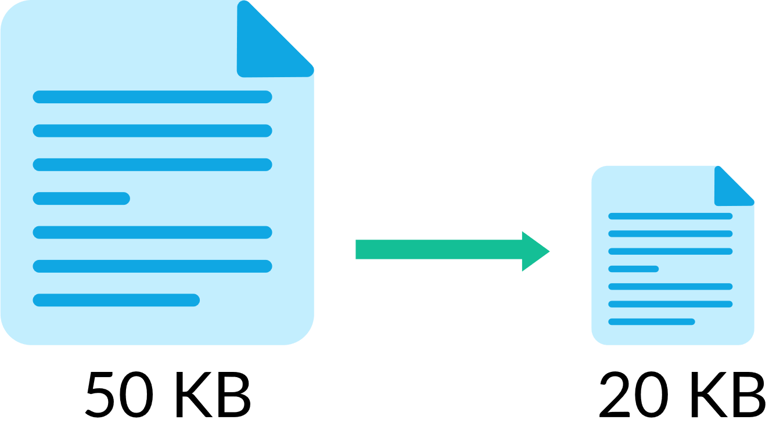
What is Image Compression?

Slide 5
Benefits of Image Compression
Easy to load files on slow devices
Easy to exchange files
Size Reduction

Slide 6
Basic Standards of Image Compression
Redundancy
Irrelevancy

Slide 7
Types of image compression
Lossy Compression Techniques
Lossless Image Compression

Slide 8
HUFFMAN CODING
It is an algorithm which works with integer length codes. A Huffman tree represents Huffman codes for the character that might appear in a text file. Unlike to ASCII or Unicode, Huffman code uses different number of bits to encode letters. If the number of occurrences of any character is more, we use fewer numbers of bits. Huffman coding is a method for the construction of minimum redundancy codes.

Slide 9
SOCKET PROGRAMMING
Socket programming is a way of connecting two nodes on a network to communicate with each other. One socket(node) listens on a port at an IP, while other socket reaches out to the other to form a connection. Server forms the listener socket while client reaches out to the server. Fusing socket programming we will transfer the manipulated, encoded, and compressed image to another station.

Slide 10
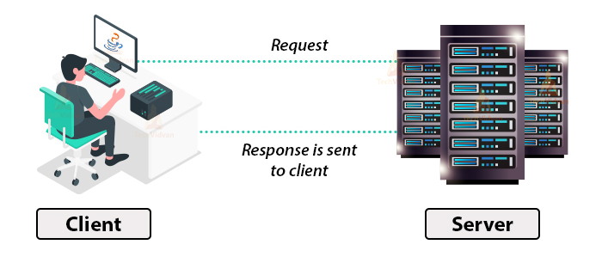

Slide 11
TCP
TCP refers to the Transmission Control Protocol, which is a highly efficient and reliable protocol designed for end-to-end data transmission over an unreliable network. A TCP connection uses a three-way handshake to connect the client and the server. It is a process that requires both the client and the server to exchange synchronization (SYN) and acknowledge (ACK) packet before the data transfer takes place

Slide 12
PROBLEM STATEMENT
In today’s scenario, use of camera, transformation of images is grown explosively. These digital picture files are huge in size and take large part of memory. While transmitting and receiving them, they waste enormous bandwidth which is a main constraint for us and while downloading of such types of files from internet takes lot of time. Further transfer of file takes much more time.
So, to resolve this issue we are using Image Compression Technique using Huffman coding and Client-Server Model to transfer the compressed image over a dedicated network using socket programming.

Slide 13
OBJECTIVE
To implement Huffman Coding algorithm for Image Compression and transformation through Socket Programming.

Slide 14
METHODOLOGY
Original Image
Compressed Image is Obtained
Applying Huffman Algorithm
Compressed Image is transfered by server through Socket Programming
File is recieved and checked by the client

Slide 15
METHODOLOGY
Phases of our Project:
Image Compression- image gets compressed at this level so a function in C is created in order to find the symbols (i.e. pixel value which is not repeated) in continuation a function is created to find the probability of each symbol. With the use of Huffman algorithm, a special code will be formulated for each pixel value so that the size of the image decreases and requires less time to transfer to the receiver’s end. We will receive a binary image in the form of .txt file.
Client- here all the compression of image would take place and size of the image. Compressed .txt file is generated through the code.
Server- The compressed file will be received at this part whose size would be less than the original image.

Slide 16
ALGORITHM HUFFMAN CODING
Step 1 : Read the Image into a 2D array(image) If the Image is in .bmp format, then the Image can be read into the 2D array. Now Create a Histogram of the pixel intensity values present in the Image with the help of 2-D array.
// Reading the BMP File into Image Array
// Creating the Histogram
// Finding number of non-zero occurrences
Step 2: Define a struct which will contain the pixel intensity values(pix),
their corresponding probabilities(freq), the pointer to the left(*left) and right(*right) child nodes and the string array for the Huffman code word(code).
Step 3: Define another Struct which will contain the pixel intensity values(pix), their corresponding probabilities(freq) and an additional field, which will be used for storing the position of new generated nodes(arrloc).
Step 4: Declaring an array of structs. Each element of the array corresponds to a node in the Huffman Tree.

Slide 17
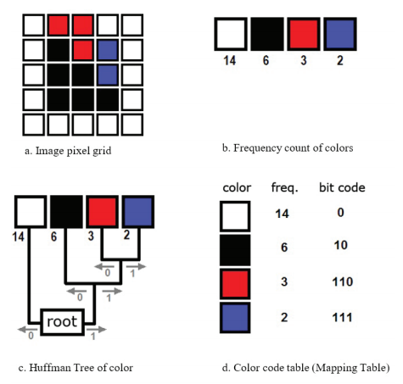
ALGORITHM HUFFMAN CODING
Step 5: Initialize the two arrays pix_freq and huff codes with information of the leaf nodes.
Step 6: Sorting the huff codes array according to the probability of occurrence of the pixel
intensity values
Step 7: Building the Huffman Tree
We start by combining the two nodes with lowest probabilities of occurrence and
then replacing the two nodes by the new node. This process continues until we have a root
node. The first parent node formed will be stored at index nodes in the array pix_freq and the
Subsequent parent nodes obtained will be stored at higher values of index.
Step 8:
Perform a traverse in Huffman Tree to generate code table. This will determine code for each
element of tree in the following way. The code for each symbol may be obtained by tracing path to the symbol from the root of the tree. A 1 is assigned for a branch in one direction and a 0 is assigned for a branch in the other direction.

Slide 18
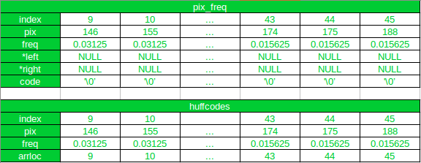
ALGORITHM HUFFMAN CODING

Slide 19
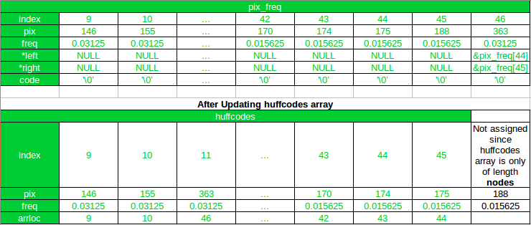
ALGORITHM HUFFMAN CODING
Now, iteration 170 and 174 will be combined, since 175 and 188 has already been combined

Slide 20
ALGORITHM SOCKET PROGRAMMING
Client Side
Start the program
Declare the variables and structures required.
A socket is created and the connect function is executed.
The file is opened.
The data from the file is read and sent to the server.
The socket is closed.
The program is stopped.

Slide 21
ALGORITHM SOCKET PROGRAMMING
Server Side
Start the program.
Declare the variables and structures required.
The socket is created using the socket function.
The socket is blinded to the specific port.
Start listening for the connections.
Accept the connection from the client.
Create a new file.
Receives the data from the client.
Write the data into the file.
The program is stopped.

Slide 22
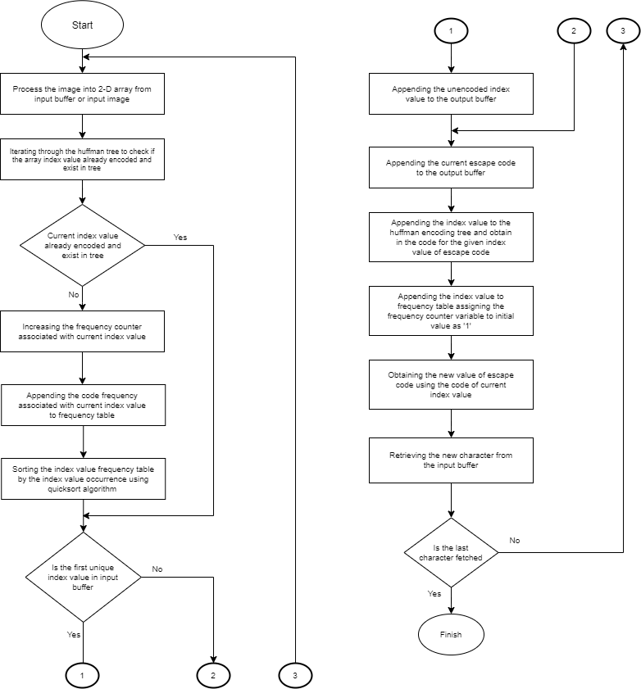
HUFFMAN CODING

Slide 23
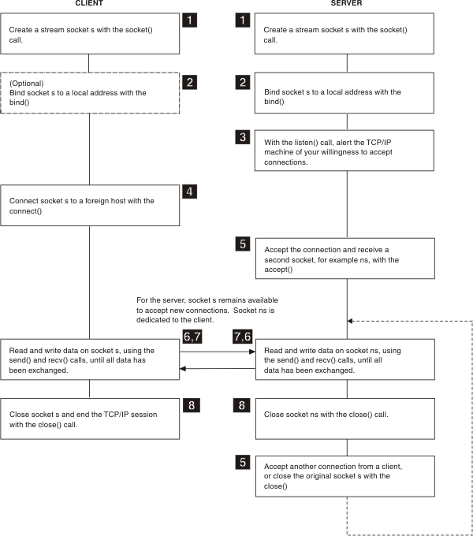
SOCKET PROGRAMMING

Slide 24
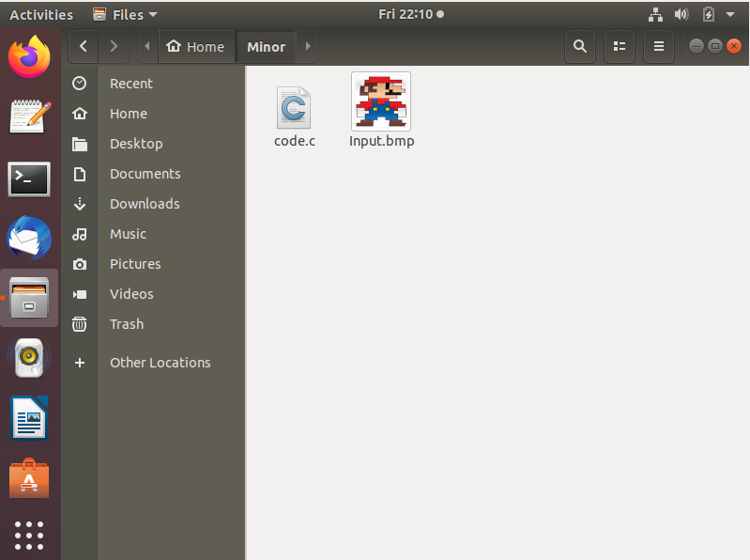
IMPLEMENTATION
Code and Input Image

Slide 25
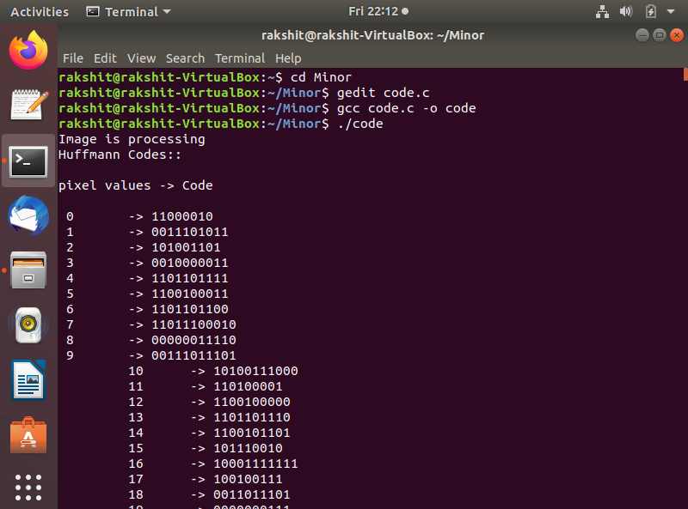
IMPLEMENTATION

Slide 26
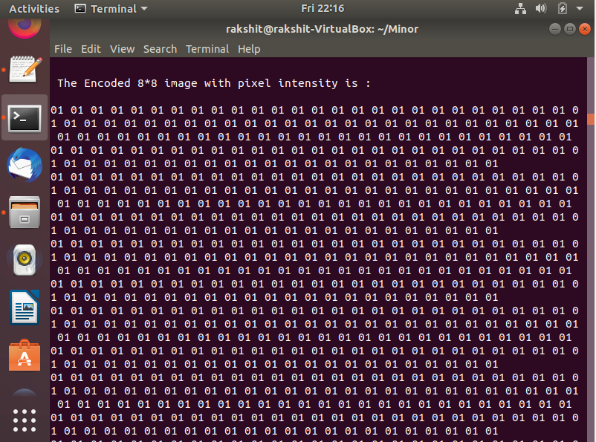
IMPLEMENTATION

Slide 27
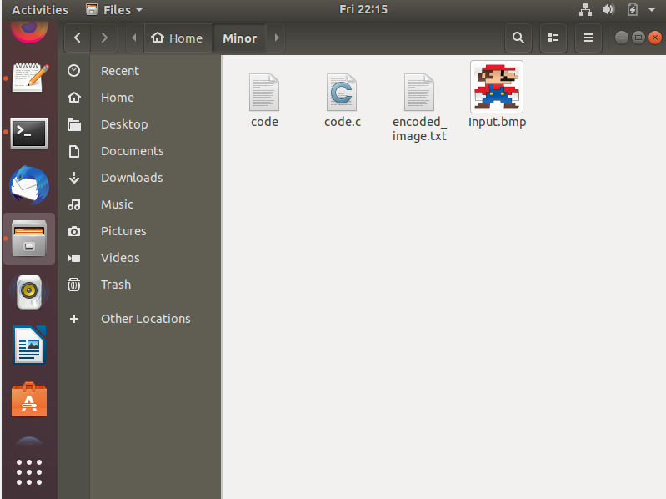
IMPLEMENTATION

Slide 28
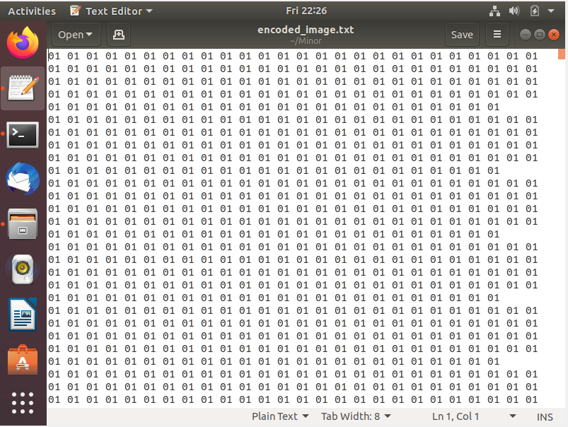
IMPLEMENTATION
Encoded Image

Slide 29
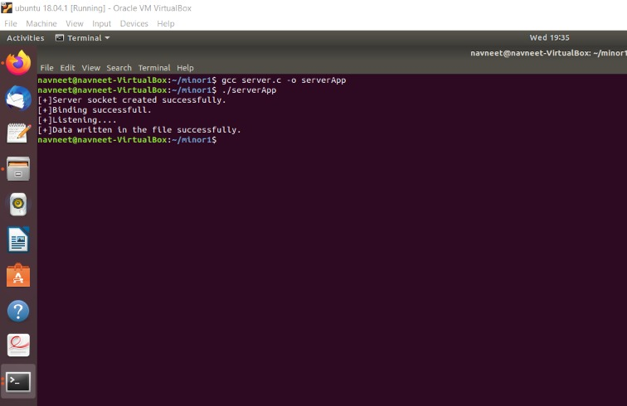
IMPLEMENTATION
SERVER

Slide 30
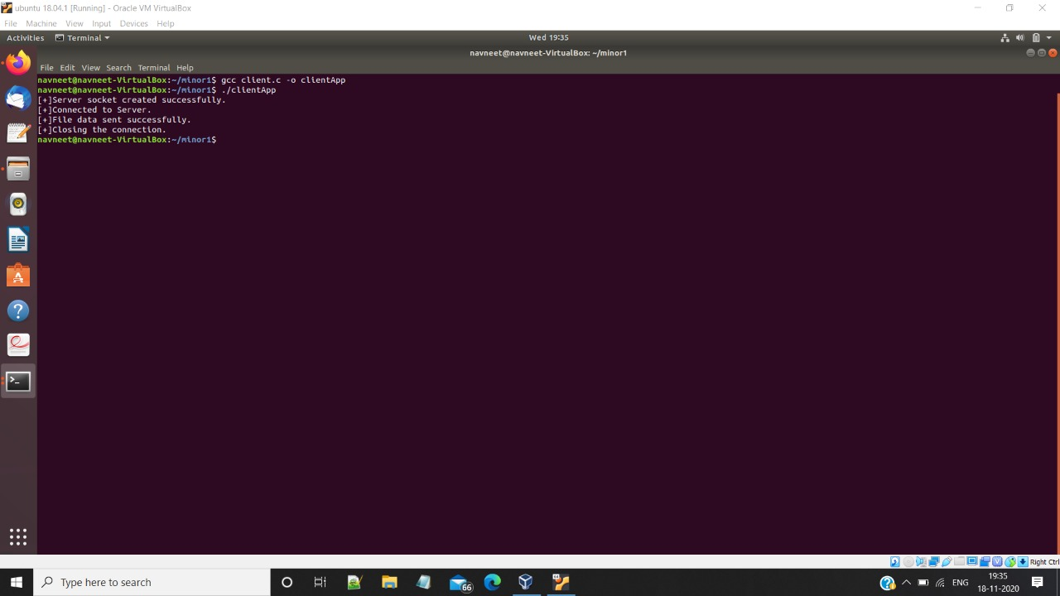
IMPLEMENTATION
CLIENT

Slide 31
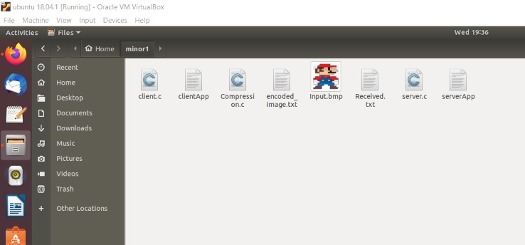
IMPLEMENTATION

Slide 32
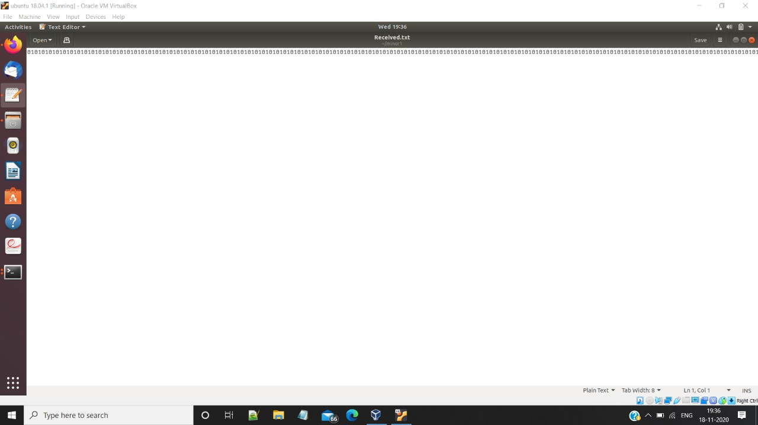
IMPLEMENTATION
RECEIVED FILE

Slide 33
SYSTEM REQUIREMENTS
HARDWARE:
64-bit processor
Minimum 4GB RAM
Processor: Intel Core i5-3230 CPU
Processor Speed: 2.60 GHz
SOFTWARE:
Operating System: Ubuntu
gcc Compiler

Slide 34
START PERIOD
Duration: 2 Weeks
Start Date: 1 SEP’ 20
End Date: 15 SEP’20
Assigned To: Aakarshit, Navneet, Rakshit, Rithik
REQUIREMENT GATHERING
Duration: 1 Week
Start Date: 16 SEP’ 20
End Date: 23 SEP’20
Assigned To: Aakarshit, Navneet, Rakshit, Rithik
DESIGN
Duration: 1 Week
Start Date: 24 SEP’ 20
End Date: 30 SEP’20
Assigned To: Aakarshit, Navneet, Rakshit, Rithik
START
IMPLEMENTATION
Duration: 3 Week
Start Date: 16 OCT’ 20
End Date: 5 NOV’20
Assigned To: Aakarshit, Navneet, Rakshit, Rithik
RELEASE PROTOTYPE
Duration: 1 Week
Start Date: 8 OCT’ 20
End Date: 15 OCT’20
Assigned To: Aakarshit, Navneet, Rakshit, Rithik
PSEUDO CODE
Duration: 1 Week
Start Date: 1 OCT’ 20
End Date: 7 OCT’20
Assigned To: Aakarshit, Navneet, Rakshit, Rithik
TESTING
Duration: 2 Weeks
Start Date: 6 NOV’ 20
End Date: 12 NOV’20
Assigned To: Aakarshit, Navneet, Rakshit, Rithik
DEBUGGING
Duration: 1 Week
Start Date: 13 NOV’ 20
End Date: 19 NOV’20
Assigned To: Aakarshit, Navneet, Rakshit, Rithik
PUBLISH
Duration: 1 Week
Start Date: 20 NOV’ 20
End Date: 27 NOV’20
Assigned To: Aakarshit, Navneet, Rakshit, Rithik
STOP

Slide 35
REFERENCES
[1] Mohammad Sajid Qamruddin Khizrai , Prof.S.T.Bodkhe , ”Image Encryption using Different Techniques for High Security Transmission over a Network”, International Journal of Engineering Research and General Science, Volume 2, Issue 4, June-July, 2014.
http://citeseerx.ist.psu.edu/viewdoc/download;jsessionid=E545D61265C706E0E270D0EA1652C154?doi=10.1.1.458.8859&rep=rep1&type=pdf
[2] Keir Davis, John W Turner, and Nathan Yocom. Client-server architecture. In The Definitive Guide to Linux Network Programming, pages 99–135. 2004.
[3] M.M. Kekic, G.N. Lu, and E.H. Carlton. Client-server computer network management architecture, December 16 2003. US Patent 6,664,978.
[4] Jouni Smed, Timo Kaukoranta, and Harri Hakonen. Aspects of networking in multiplayer computer games. The Electronic Library, 20(2):87–97, 2002.
[5] Greg Humphreys, Mike Houston, Ren Ng, Randall Frank, Sean Ahern, Peter D Kirchner, and James T Klosowski. Chromium: a stream-processing framework for interactive rendering on clusters. In ACM Transactions on Graphics, volume 21, pages 693–702, 2002.

